Slide 1



Noida Institute of Engineering and Technology, Greater Noida
Cryptography and Network Security
Unit: 4
Cyber Security
ANC0301
Sujeet Singh Bhadouria
Assistant Professor
(CSE)
NIET, Gr. Noida
(B Tech IIIrd Sem)

Slide 2

Faculty Profile
FACULTY PROFILE
Name of Faculty: Sujeet Singh Bhadouria
Designation & Department: Assistant Professor, CSE
Qualification: Ph.D (Pre-Submission) M.Tech
Experience: 10 Years of teaching experience
Area of Interest: Computer Network
Reviewer: IET Communications ISSN 1751-8644 (SCI & SCOPUS INDEX)
Research Publications:
International Journal 09
Paper Presentation 06
International Patent 01 (Granted)
National Patent 04

Slide 3
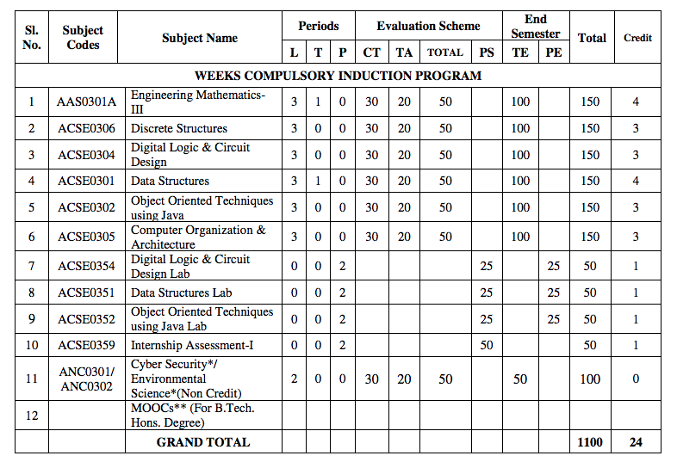
Evaluation Scheme

Slide 4
Syllabus
Introduction:
Introduction to Information Systems: Types of Information Systems, Development of Information Systems, Need for Information Security, Threats to Information Systems, Information Assurance, Guidelines for Secure Password and WI-FI Security and social media and Windows Security, Security Risk Analysis and Risk Management.
Application Layer Security:
Data Security Considerations-Backups, Archival Storage and Disposal of Data, Security Technology-Firewall, Intrusion Detection, Access Control, Security Threats -Viruses, Worms, Trojan Horse, Bombs, Trapdoors, Spoofs, E-mail Viruses, Macro Viruses, Malicious Software, Network and Denial of Services Attack, Security, Threats to E-Commerce: Electronic Payment System, e- Cash, Issues with Credit/Debit Cards.

Slide 5
Syllabus
Secure System Development:
Application Development Security, Architecture & Design, Security Issues in Hardware: Data Storage and Downloadable Devices, Mobile Protection, Security Threats involving in social media, Physical Security of IT Assets, Access Control, CCTV and Intrusion Detection Systems, Backup Security Measures.
Cryptography and Network Security:
Public key cryptography: RSA Public Key Crypto with implementation in Python, Digital Signature Hash Functions, Public Key Distribution.
Symmetric key cryptography: DES (Data Encryption Standard), AES (Advanced Encryption Standard), Secure hash algorithm (SHA-1).
Real World Protocols: Basic Terminologies, VPN, Email Security Certificates, Transport Layer Security (TLS), IP security, DNS Security.

Slide 6
Syllabus
Security Policy:
Policy design Task, WWW Policies, Email based Policies, Policy Revaluation Process-Corporate Policies-Sample Security Policies, Publishing and Notification Requirement of the updated and new Policies.
Recent trends in security.

Slide 7
Applications
There are many cyber security real-life examples where financial organizations like banks and social organizations, weather channels etc. have faced cyber-attacks and have lost valuable information and resources. To fix these problems, you'll need comprehensive cyber security awareness.
According to KPMG, the annual compensation for cyber security heads ranges from 2 Cr to 4 Cr annually. The industry also reports a satisfaction level of 68%, making it a mentally and financially satisfying career for most.

Slide 8
Course Objective
Students will learn about :
Security of Information system and Risk factors.
Examine security threats and vulnerability in various scenarios.
Understand concept of cryptography and encryption technique to protect the data from cyber-attack
Provide protection for software and hardware.

Slide 9
Course Outcome
COURSE OUTCOME NO. | COURSE OUTCOMES | Bloom’s Knowledge Level (KL)
CO1 | Analyze the cyber security needs of an organization. | K4
CO2 | Identify and examine software vulnerabilities and security solutions. | K1, K3
CO3 | Comprehend IT Assets security (hardware and Software) and performance indicators. | K2
CO4 | Measure the performance and encoding strategies of security systems. | K3, K5
CO5 | Understand and apply cyber security methods and policies to enhance current scenario security. | K2, K3

Slide 10
Program Outcomes
Engineering knowledge
Problem analysis
Design/development of solutions
Conduct investigations of complex problems
5. Modern tool usage
The engineer and society
Environment and sustainability

Slide 11
Program Outcomes…(cont.)
8. Ethics
9. Individual and team work
10. Communication
11. Project Management and Finance
12. Life Long learning

Slide 12
CO-PO Mapping
CO-PO Mapping
PO No. CO No. | PO1 | PO2 | PO3 | PO4 | PO5 | PO6 | PO7 | PO8 | PO9 | PO10 | PO11 | PO12
CO1 | 2 | 2 | 1 | 2 | - | - | - | 1 | 2 | 1 | 2 | 2
CO2 | 2 | 2 | 2 | 2 | 2 | 1 | - | 1 | 2 | 1 | 2 | 2
CO3 | 2 | 2 | 1 | 2 | 2 | - | - | 1 | 2 | 1 | 2 | 2
CO4 | 2 | 2 | 1 | 2 | 2 | 1 | - | 1 | 2 | 1 | 2 | 2
CO5 | 2 | 2 | 1 | 2 | 2 | - | - | 1 | 2 | 1 | 2 | 2
*3= High *2= Medium *1=Low

Slide 13
Program Specific Outcomes
Program Specific Outcomes (PSOs) are what the students should be able to do at the time of graduation. The PSOs are program specific. PSOs are written by the department offering the program.
On successful completion of B. Tech. (CSE) Program, the Information and Technology engineering graduates will be able to:
PSO1 : Work as a software developer, database administrator, tester or networking engineer for providing solutions to the real world and industrial problems.
PSO2 : Apply core subjects of information technology related to data structure and algorithm, software engineering, web technology, operating system, database and networking to solve complex IT problems
PSO3 : Practice multi-disciplinary and modern computing techniques by lifelong learning to establish innovative career
PSO4 : Work in a team or individual to manage projects with ethical concern to be a successful employee
or employer in IT industry.

Slide 14
PSO Mapping
Program Specific Outcomes and Course Outcomes Mapping
CO | PSO1 | PSO2 | PSO3 | PSO4
CO1 | 2 | 2 | - | 2
CO2 | 2 | 2 | 1 | 2
CO3 | 2 | 2 | - | 2
CO4 | 2 | 2 | - | 2
CO5 | 2 | 2 | - | 2
*3= High *2= Medium *1=Low

Slide 15

Program Educational Objectives
The Program Educational Objectives (PEOs) of an engineering degree program are the statements that describe the expected achievements of graduates in their career, and what the graduates are expected to perform and achieve during the first few years after graduation.
PEO1: To have an excellent scientific and engineering breadth so as to comprehend, analyze, design and solve real-life problems using state-of-the-art technology.
PEO2: To lead a successful career in industries or to pursue higher studies or to understand entrepreneurial endeavors.
PEO3: To effectively bridge the gap between industry and academics through effective communication skill, professional attitude and a desire to learn.

Slide 16
Result Analysis
Faculty Name | Subject Name | Code | Result
Ms Ruchika Sharma | Cyber Security | ANC0301 | 100%

Slide 17
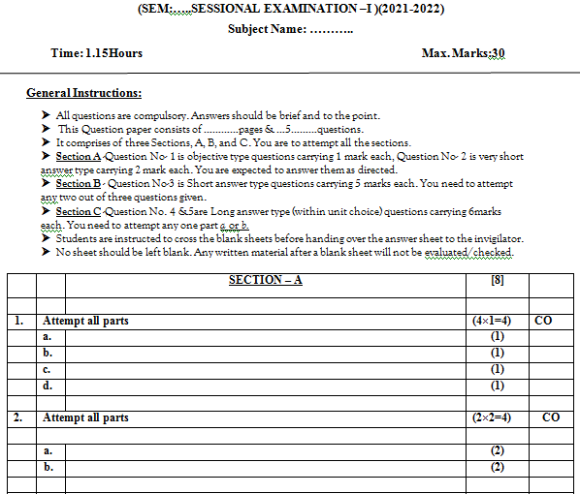
Question Paper Template

Slide 18
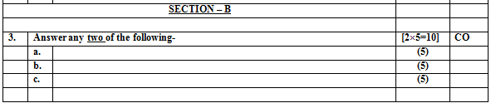
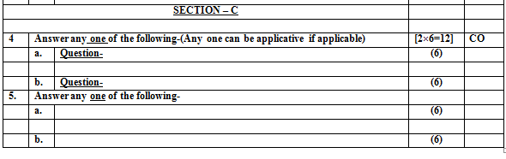
Question Paper Template

Slide 19
Question Paper Template
 |  | SECTION – A |  | CO
1. | Attempt all parts- |  | [10×1=10]
 | 1-a. | Question- | -1
 | 1-b. | Question- | -1
 | 1-c. | Question- | -1
 | 1-d. | Question- | -1
 | 1-e. | Question- | -1
 | 1-f. | Question- | -1
 | 1-g. | Question- | -1
 | 1-h. | Question- | -1
 | 1-i. | Question- | -1
 | 1-j. | Question- | -1
2 | Attempt all parts- |  | [5×2=10] | CO
 | 2-a. | Question- | -2
 | 2-b. | Question- | -2
 | 2-c. | Question- | -2
 | 2-d. | Question- | -2
 | 2-e. | Question- | -2

Slide 20
Question Paper Template
SECTION – B |  |  |  | CO
3 | Answer any five of the following- |  | [5×6=30]
 | 3-a. | Question- | -6
 | 3-b. | Question- | -6
 | 3-c. | Question- | -6
 | 3-d. | Question- | -6
 | 3-e. | Question- | -6
 | 3-f. | Question- | -6
 | 3-g. | Question- | -6

Slide 21
Question Paper Template
SECTION – C ​ |  |  | ​ | CO​
​ |  |  | ​ | ​
4​ | Answer any one of the following-​ |  | [5×10=50]​ | ​
​ | 4-a.​ | Question- ​ | -10​ | ​
​ | ​ | ​ | ​ | ​
​ | 4-b.​ | Question- ​ | -10​ | ​
5​ | Answer any one of the following-​ |  | ​ | ​
​ | 5-a.​ | Question- ​ | -10​ | ​
​ | ​ | ​ | ​ | ​
​ | 5-b.​ | Question- ​ | -10​ | ​
6​ | Answer any one of the following-​ |  | ​ | ​
​ | 6-a.​ | Question- ​ | -10​ | ​
​ | ​ | ​ | ​ | ​
​ | 6-b.​ | Question- ​ | -10​ | ​
7​ | Answer any one of the following-​ |  | ​ | ​
​ | 7-a.​ | Question- ​ | -10​ | ​
​ | ​ | ​ | ​ | ​
​ | 7-b.​ | Question- ​ | -10​ | ​
​ | ​ | ​ | ​ | ​
8​ | Answer any one of the following-​ |  | ​ | ​
​ | 8-a.​ | Question- ​ | -10​ | ​
​ | ​ | ​ | ​ | ​
​ | 8-b.​ | Question- ​ | -10​ | ​

Slide 22
Prerequisite/Recap
Basics recognition in the domain of Computer Science.
Concept of network and operating system.
Commands of programming language.

Slide 23

Content (Unit-4)
Public key cryptography: RSA Public Key Crypto with implementation in Python, Digital Signature, Hash Functions, Public Key Distribution.
Symmetric key cryptography: DES (Data Encryption Standard), AES (Advanced Encryption Standard), Secure hash algorithm (SHA-1).
Real World Protocols: Basic Terminologies, VPN, Email Security Certificates, Transport Layer Security, TLS, IP security, DNS Security.

Slide 24
Unit Objective/Outcomes
Topic | Objective
RSA IMPLEMENTATION IN PYTHON | To implement RSA in python language.
DIGITAL SIGNATURE | Digital signatures are used to meet three important goals of information security: integrity, authentication, and non-repudiation.
HASH FUNCTIONS | Cryptographic Hash Functions are used to achieve a number of Security goals like Message Authentication, Message Integrity, and are also used to implement Digital Signatures (Non-repudiation), and Entity Authentication.
PUBLIC KEY DISTRIBUTION | In public key cryptography, the key distribution of public keys is done through public key servers.
DES | Data Encryption is used to deter malicious or negligent parties from accessing sensitive data. An important line of defense in a cyber security architecture, encryption makes using intercepted data as difficult as possible.
AES | Asymmetric cryptography, also known as public-key cryptography, is a process that uses a pair of related keys -- one public key and one private key -- to encrypt and decrypt a message and protect it from unauthorized access or use.

Slide 25
Topic Mapping with CO
Topic | CO
RSA IN PYTHON | CO4
DIGITAL SIGNATURE | CO4
HASH FUNCTIONS | CO4
PUBLIC KEY DISTRIBUTION | CO4
DES | CO4
AES | CO4

Slide 26
Introduction (CO4)
Modern life depends on online services, so having a better understanding of cyber security threats is vital.
The course will improve your online safety in the context of the wider world, introducing concepts like malware, trojan virus, network security, cryptography, identity theft, and risk management.
https://www.javatpoint.com/cyber-security-introduction
https://www.edureka.co/blog/what-is-cybersecurity/
http://natoassociation.ca/a-short-introduction-to-cyber-security/

Slide 27
Introduction(CO4)
Cryptography :
It is the art of secret writing.
Network :
Network is collection of computers linked/connected together via connecting network devices like modem, routers, bridge, repeater etc.
Network Security :
Nowadays, everything is performed on Internet, so it is necessary to provide security for the data which is transferred between computer systems.
“Providing security for the data over the network.”

Slide 28
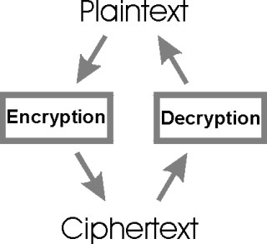
Introduction
Plain Text :
Normal text that can be read by user and is in readable format.
Cipher Text :
It is in unreadable format and user have to convert cipher text to plain text.

Slide 29
Introduction
2 Ways of Encryption
Stream ciphers :
In stream ciphers the encryption is done bit by bit.
Block ciphers :
In block ciphers the encryption is done block by block, where a block is group of bits.

Slide 30
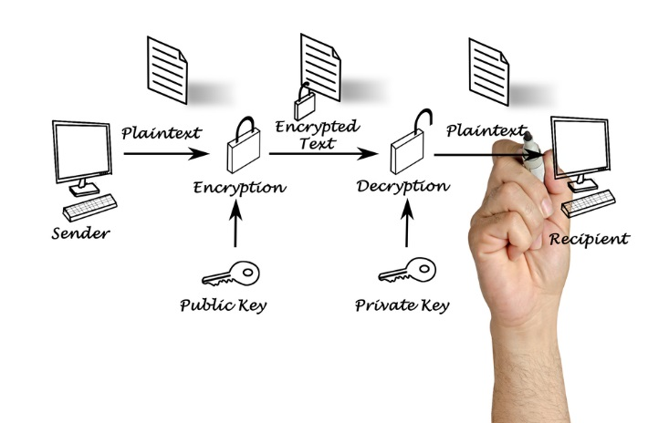
Introduction
There are 2 mechanisms for encryption.
1. Asymmetric key encryption or public key encryption.
A pair of public key and private key is used for encryption and decryption.

Slide 31
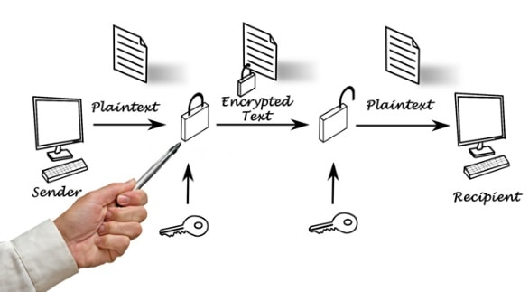
Introduction
2. Symmetric key encryption or secret key encryption or single key encryption.
Same key is used for encryption and decryption.

Slide 32
RSA Algorithm(CO4)
RSA is the most common public-key algorithm, named after its inventors Rivest, Shamir, and Adelman (RSA).RSA encryption algorithm is a type of public-key encryption algorithm. To better understand RSA, lets first understand what is public-key encryption algorithm.
Public key encryption algorithm:
Public Key encryption algorithm is also called the Asymmetric algorithm. Asymmetric algorithms are those algorithms in which sender and receiver use different keys for encryption and decryption. Each sender is assigned a pair of keys:
Public key
Private key
The Public key is used for encryption, and the Private Key is used for decryption. Decryption cannot be done using a public key. The two keys are linked, but the private key cannot be derived from the public key. The public key is well known, but the private key is secret and it is known only to the user who owns the key. It means that everybody can send a message to the user using user's public key. But only the user can decrypt the message using his private key.

Slide 33
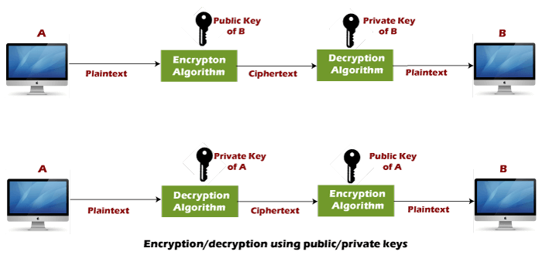
RSA Algorithm(CO4)
The Public key algorithm operates in the following manner:
The data to be sent is encrypted by sender A using the public key of the intended receiver
B decrypts the received ciphertext using its private key, which is known only to B. B replies to A encrypting its message using A's public key.
A decrypts the received ciphertext using its private key, which is known only to him.

Slide 34
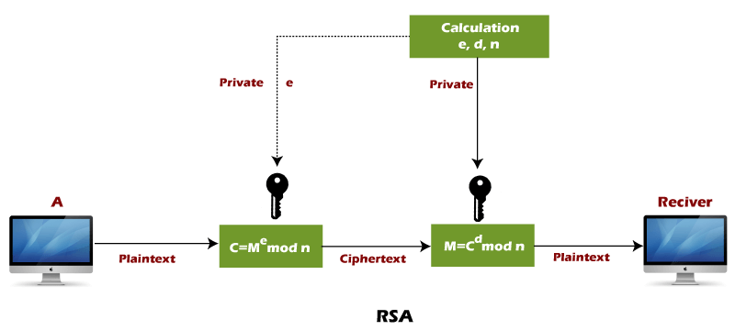
RSA Algorithm(CO4)

Slide 35
RSA Algorithm(CO4)
RSA algorithm uses the following procedure to generate public and private keys:
Select two large prime numbers, p and q.
Multiply these numbers to find n = p x q, where n is called the modulus for encryption and decryption.
Choose a number e less than n, such that n is relatively prime to (p - 1) x (q -1). It means that e and (p - 1) x (q - 1) have no common factor except 1. Choose "e" such that 1<e < φ (n), e is prime to φ (n),
gcd (e,d(n)) =1
If n = p x q, then the public key is <e, n>. A plaintext message m is encrypted using public key <e, n>. To find ciphertext from the plain text following formula is used to get ciphertext C.

Slide 36
RSA Algorithm(CO4)
C = m^{e} mod n
Here, m must be less than n. A larger message (>n) is treated as a concatenation of messages, each of which is encrypted separately.
To determine the private key, we use the following formula to calculate the d such that:
D_{e} mod {(p - 1) x (q - 1)} = 1
Or
D_{e} mod φ (n) = 1
The private key is <d, n>. A ciphertext message c is decrypted using private key <d, n>. To calculate plain text m from the ciphertext c following formula is used to get plain text m.
m = c^{d} mod n

Slide 37
RSA Algorithm(CO4)
1. Two large prime numbers are considered. Let them be p,q.
2. Calculate n = p q and (φ) phi = (p-1) (q-1).
3. Select e, public key, such that 1 < e < phi and gcd (e, phi) = 1,i.e e is not a factor of (p-1) and(q-1).
4. Calculate d, the private key, such that de =1 mod phi.
One key is (n, e) and the other key is (n, d). The values of p, q, and phi should also be kept secret.
n is considered to be the modulus.
e is considered to be the public key.
d is considered to be the secret key.

Slide 38
RSA Algorithm
Encryption
Sender A does the following:
1. Get the recipient B's public key (n, e).
2. Identify the plaintext message as a positive integer m.
3. Calculate the cipher text c = m^e mod n.
4. Transmits the cipher text c to receiver B.
Decryption
Recipient B is supposed to perform the following functions:
1. Make a consideration to adapt his or her own private key (n, d) and depict a complete computation in plain text m = c^d mod n.
2. Perform a conversion of the integer so that it can be in plain text form

Slide 39
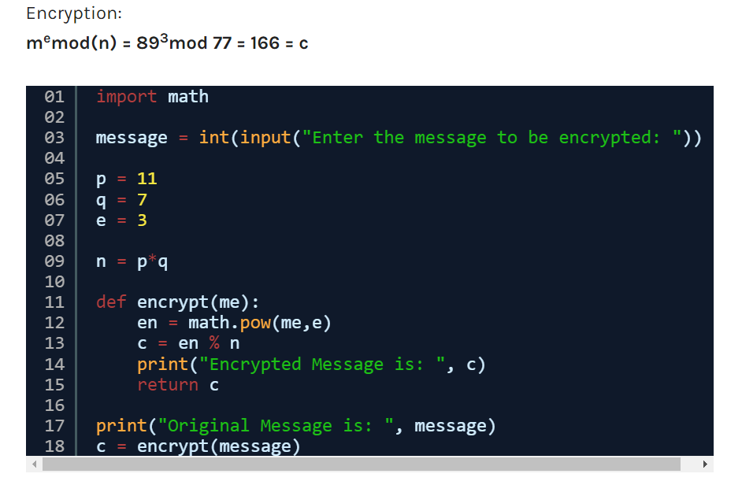
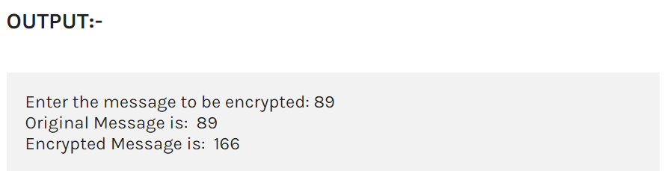
RSA Public key crypto in python

Slide 40
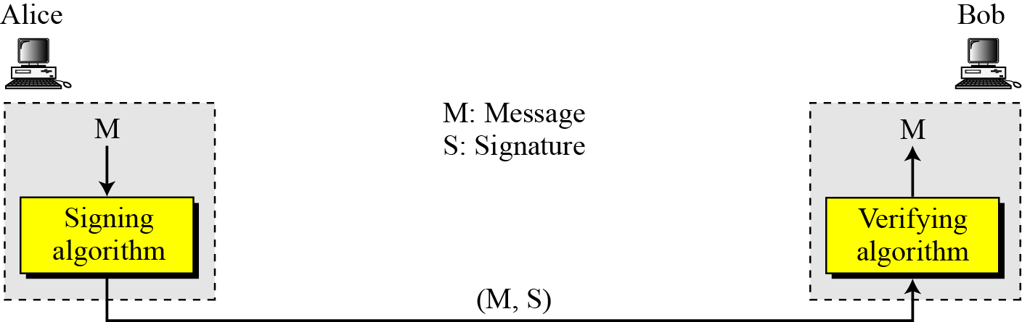
Digital Signature (CO4)
In digital signature process the sender uses a signing algorithm to sign the message. The message and the signature are sent to the receiver. The receiver receives the message and the signature and applies the verifying algorithm to the combination. If the result is true, the message is accepted; otherwise, it is rejected.
Digital signature process

Slide 41
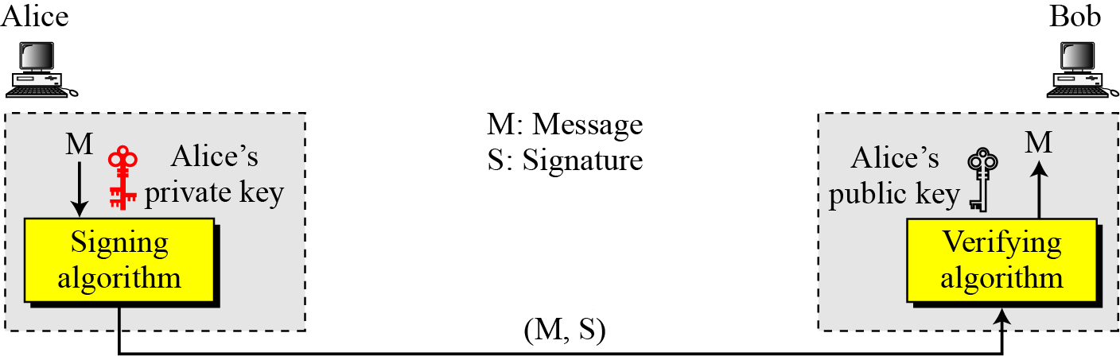

Digital Signature
Adding key to the digital signature process
Note
A digital signature needs a public-key system.
The signer signs with her private key; the verifier verifies with the signer’s public key.

Slide 42
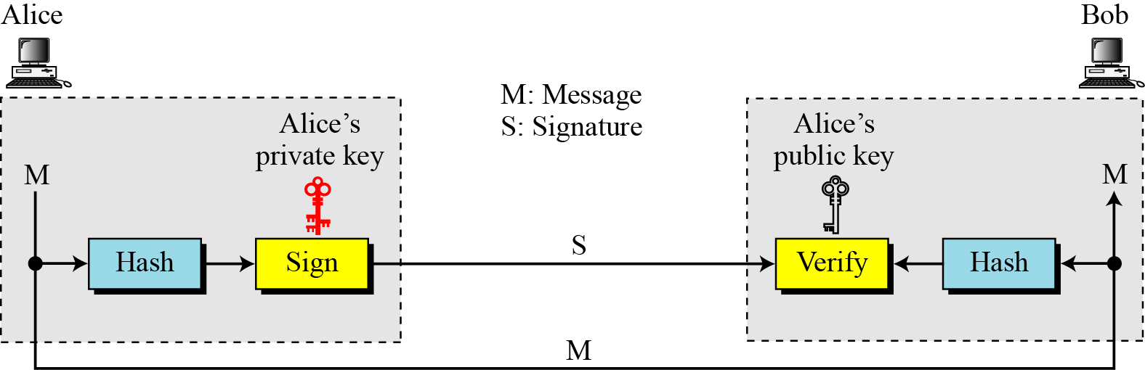
Digital Signature
Signing the digest
Note
A cryptosystem uses the private and public keys of the receiver: a digital signature uses
the private and public keys of the sender.

Slide 43
Hash Function(CO4)
A cryptographic hash function is an algorithm that takes an arbitrary amount of data input—a credential—and produces a fixed-size output of enciphered text called a hash value, or just “hash.” That enciphered text can then be stored instead of the password itself, and later used to verify the user.
Certain properties of cryptographic hash functions impact the security of password storage.
Non-reversibility, or one-way function. A good hash should make it very hard to reconstruct the original password from the output or hash.

Slide 44
Hash Function
Diffusion, or avalanche effect. A change in just one bit of the original password should result in change to half the bits of its hash. In other words, when a password is changed slightly, the output of enciphered text should change significantly and unpredictably.
Determinism. A given password must always generate the same hash value or enciphered text.
Collision resistance. It should be hard to find two different passwords that hash to the same enciphered text.
Non-predictable. The hash value should not be predictable from the password.

Slide 45
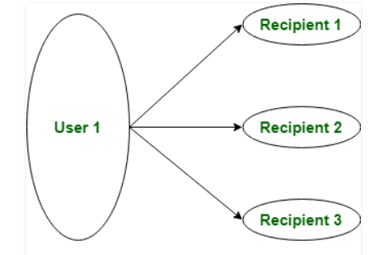
Public-key Distribution
In cryptography it is a very tedious task to distribute the public and private key between sender and receiver. If key is known to the third party (forger/eavesdropper) then the whole security mechanism becomes worthless.
So, there comes the need to secure the exchange of keys.
Public key can be distributed in 4 ways: Public announcement, Publicly available directory, Public-key authority, and Public-key certificates. These are explained as following below.
Public Announcement: Here the public key is broadcasted to everyone. Major weakness of this method is forgery. Anyone can create a key claiming to be someone else and broadcast it. Until forgery is discovered can masquerade as claimed user.

Slide 46
Public-key Distribution
2. Publicly Available Directory: In this type, the public key is stored at a public directory. Directories are trusted here, with properties like Participant Registration, access and allow to modify values at any time, contains entries like {name, public-key}.Directories can be accessed electronically still vulnerable to forgery or tampering.
3. Public Key Authority: It is similar to the directory but, improve security by tightening control over distribution of keys from directory. It requires users to know public key for the directory. Whenever the keys are needed, a real-time access to directory is made by the user to obtain any desired public key securely.
4. Public Certification: This time authority provides a certificate (which binds identity to the public key) to allow key exchange without real-time access to the public authority each time. The certificate is accompanied with some other info such as period of validity, rights of use etc. All of this content is signed by the trusted Public-Key or Certificate Authority (CA) and it can be verified by anyone possessing the authority’s public-key.

Slide 47
Data Encryption Standard (DES) CO4
DES Algorithm
This is the most common encryption. It mainly consists of two common inputs in the encryption function, which includes the key and the plain text.
The plain text must be a 64-bit combination in length where the key should be having a length of 56 bits.
The 64 bits of plain text will first go through initial permutation which can then rearrange the bits. Second, a 16 round of a similar function is articulated.
This will include both permutation and substitution functionalities. This is then followed by a pre-output which is swapped at 32 bits position and passes through a final permutation so as to come up with an end set of 64-bit text cipher.

Slide 48
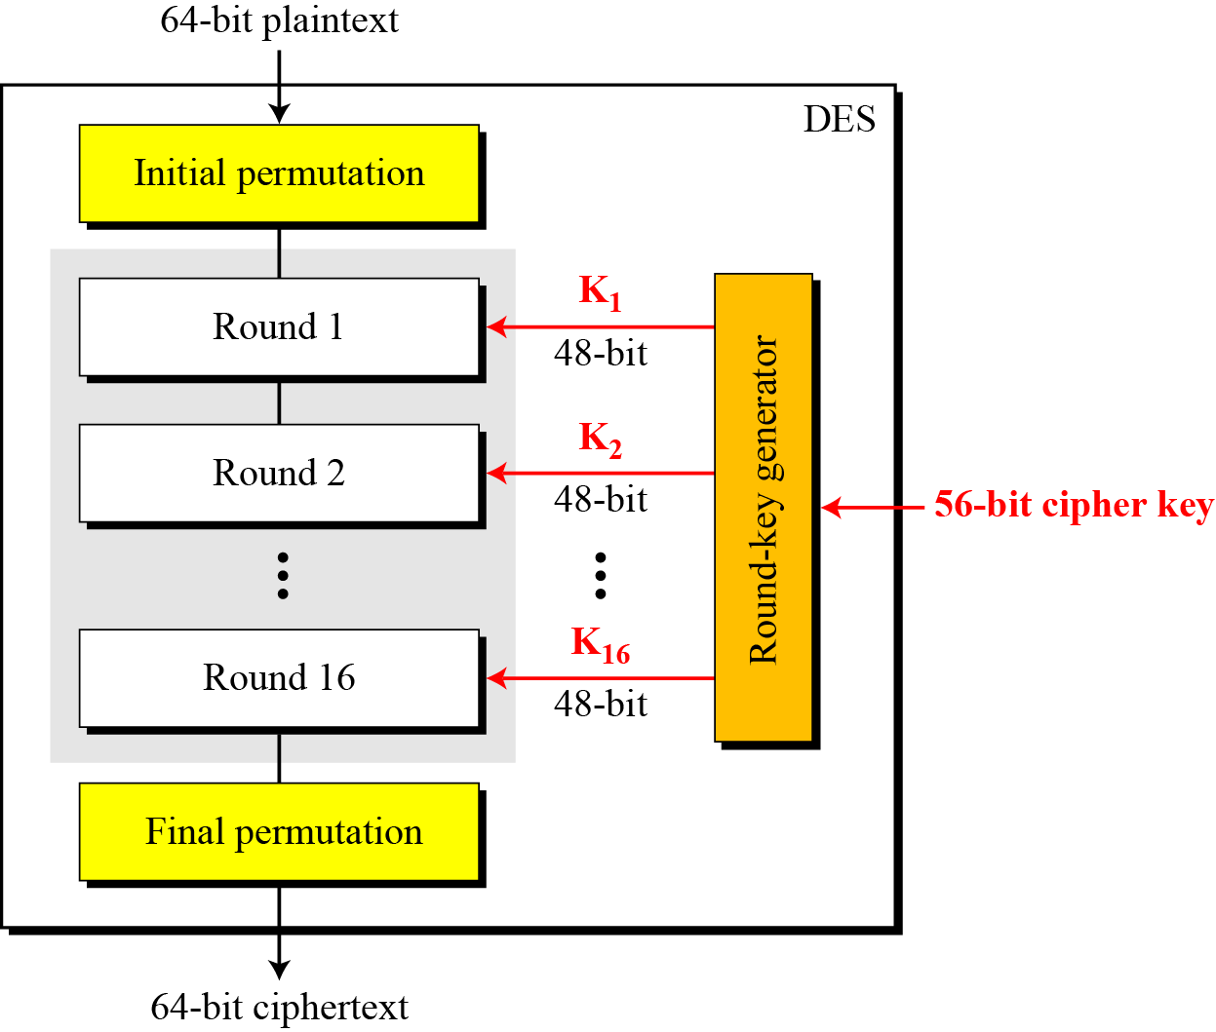
Data Encryption Standard (DES) CO4
The encryption process is made of two permutations (P-boxes), which we call initial and final permutations, and sixteen Feistel rounds.
General structure of DES

Slide 49
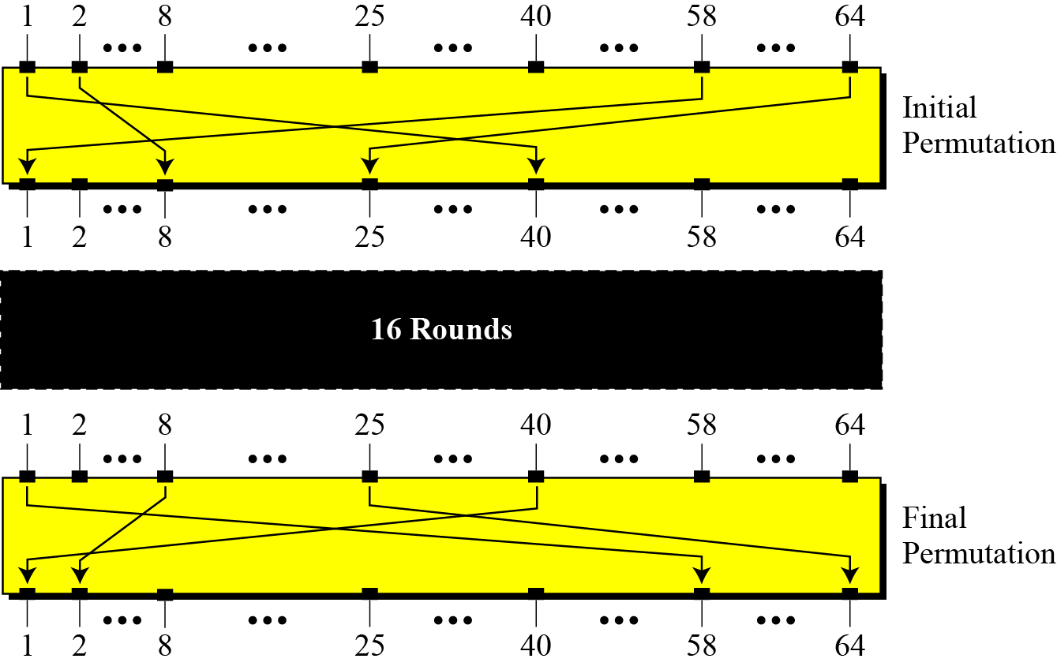
Data Encryption Standard (DES)
Initial and final permutation steps in DES

Slide 50
Data Encryption Standard (DES)
Initial and final permutation tables

Slide 51
Advanced Encryption Standard (AES)-CO4
This type of encryption was mainly chosen for use in the year 2001.
It is also regarded as an iterated block cipher, which consists of 10, 12, and 14 key size rounds with respective key sizes of 128, 192, and 256 bits.
This mode provides an optimal performance symmetric key encryption and decryption.
It is 6 times faster than triple DES.

Slide 52
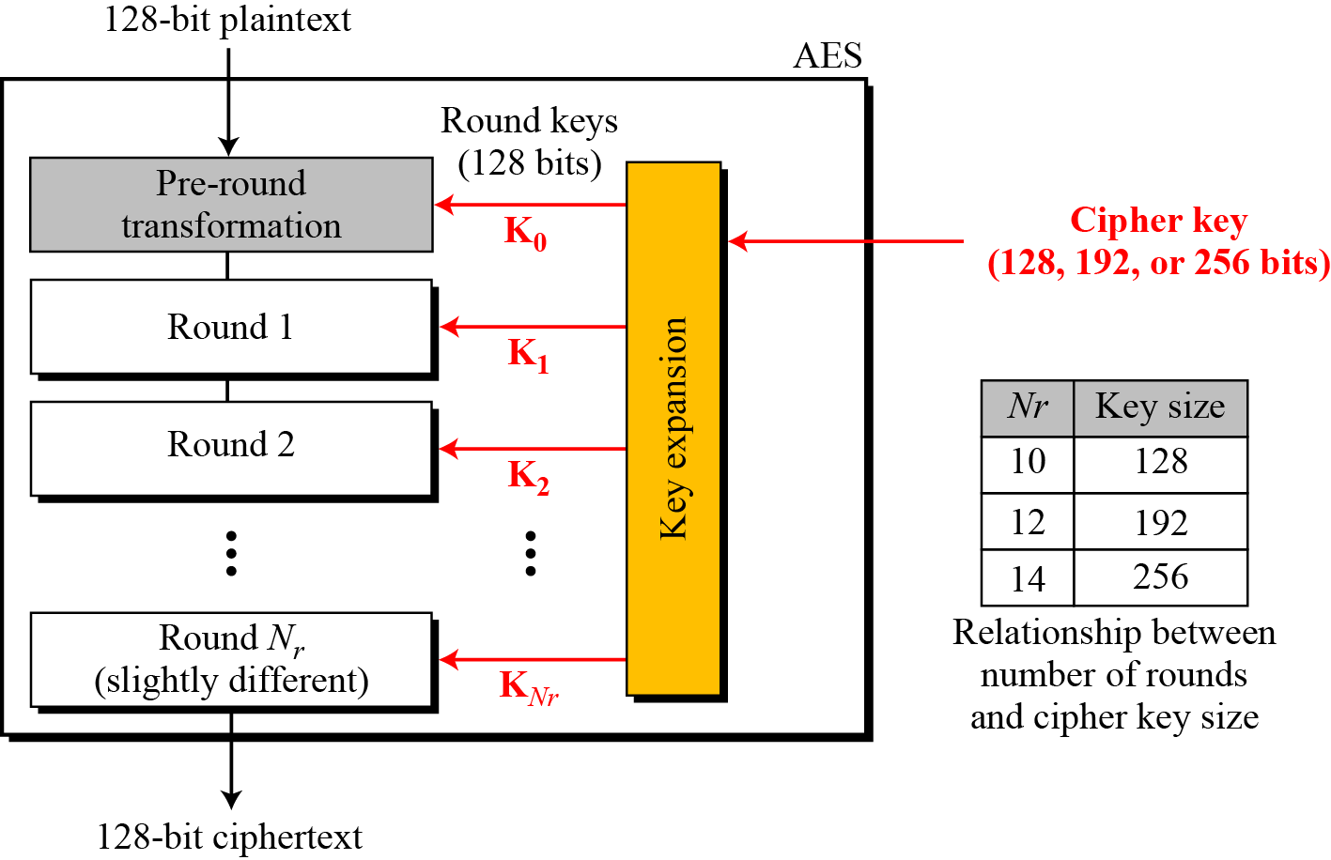
AES encryption cipher
General design of AES encryption cipher

Slide 53
SHA : Secure Hash Algorithms (CO4)
The Secure Hash Algorithm 1 (SHA-1) is a cryptographic computer security algorithm. It was created by the US National Security Agency in 1995, after the SHA-0 algorithm in 1993, and it is part of the Digital Signature Algorithm or the Digital Signature Standard (DSS).
SHA-1 produces a 160-bit hash value or message digests from the inputted data (data that requires encryption), which resembles the hash value of the MD5 algorithm.
It uses 80 rounds of cryptographic operations to encrypt and secure a data object.
Some of the protocols that use SHA-1 include:
Transport Layer Security (TLS)
Secure Sockets Layer (SSL)
Pretty Good Privacy (PGP)

Slide 54
SHA : Secure Hash Algorithms
Pretty Good Privacy (PGP)
Secure Shell (SSH)
Secure/Multipurpose Internet Mail Extensions (S/MIME)
Internet Protocol Security (IPSec)
SHA-1 is commonly used in cryptographic applications and environments where the need for data integrity is high. It is also used to index hash functions and identify data corruption and checksum errors.

Slide 55
Real world Protocols
A cryptographic protocol (also known as encryption protocol or security protocol) is an abstract or an existing protocol that performs a security-related function and applies cryptographic methods.
A protocol describes how the cryptographic algorithms should be used to secure information.
Real world protocols are used have security while transmitting data from one end to another end. Some of them includes –
VPN, Email Security Certificates, Transport Layer Security (TLS), IP security (IPSec), DNS Security.

Slide 56
Virtual Private Network (VPN)
VPN is a private communication network, which is the most secure, remote method of connecting a computer to a private network with the help of a public network, such as the Internet.
It creates the virtual tunnel through which the data travels from one computer to the other over the network.
Due to this, an attacker gets the way to use the remote client to relay attacks through the VPN tunnel.

Slide 57
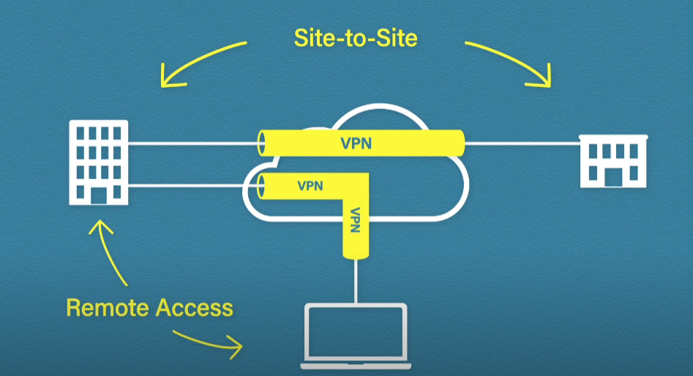
Site to Site and Remote-Access VPNs

Slide 58
E-mail Security Certificates (CO4)
E-mail security can be defined as the use of various techniques to secure sensitive information in email communication and accounts against unauthorized access, loss, or compromise.
For this there is a need of E-mail security certificates also known as S/MIME (Secure Multipurpose Internet Mail Extensions)

Slide 59
E-mail Security Certificates
S/MIME (Secure Multipurpose Internet Mail Extensions) keeps your emails protected during transition.
S/MIME uses cryptography to digitally sign and encrypt your email to prevent interception from any unauthorised person.
Email certificates, also known as S/MIME certificates are digital certificates that can be used to sign and encrypt email messages.
When you encrypt and email using an email certificate, only the person that you send it to can decrypt and read the email.
The recipient can also be sure that the email hasn’t been changed in any way.

Slide 60
E-mail Security Certificates
S/MIME includes two security features :
Email encryption : It encrypt the content of the email sent between two S/MIME enabled users to make it unreadable to anyone other than the intended recipient.
Digital signature : It digitally signed the email send between two S/MIME enabled users to eliminate any risk of spoofing.

Slide 61
Transport Layer Security (TLS) CO4
Transport Layer Security (TLS) encrypts data sent over the Internet to ensure that eavesdroppers and hackers are unable to see what you transmit which is particularly useful for private and sensitive information such as passwords, credit card numbers, and personal correspondence.
TLS is a cryptographic protocol that provides end-to-end security of data sent between applications over the Internet.
It is mostly familiar to users through its use in secure web browsing, and in particular the padlock icon that appears in web browsers when a secure session is established.
However, it can and indeed should also be used for other applications such as e-mail, file transfers, video/audioconferencing, instant messaging and voice-over-IP, as well as Internet services.

Slide 62
IP Security (CO4)
IPSec is a security protocol which is used to provide security at the network layer of the networking system.
IPSec authenticates and encrypts the data packets over an IP network.
IPSec is a security protocol which is used to provide security at the network layer of the networking system.
IPSec authenticates and encrypts the data packets over an IP network.

Slide 63
IP Security
Features of IPSec:
It guards the overall data packet produced at the IP layer inclusive of the higher layer headers.
IPSec works in between two different networks, therefore, adoption of security features is easier to implement without making any changes in the running applications.
Provisions host-based security as well.
The most frequent task of IPSec is to secure VPN network (a virtual private network) between two different network entities.

Slide 64
DNS Security
The Domain Name System (DNS) is the protocol that makes the Internet usable by allowing the use of domain names. DNS is widely trusted by organizations, and DNS traffic is typically allowed to pass freely through network firewalls.
As a result, the security of DNS is a critical component of network security.
DNS is important because it links the domain name to the IP. Internet criminals can exploit these weaknesses and are capable of creating false DNS records. These fake records can trick users into visiting fake websites, downloading malicious software, or worse.

Slide 65
Faculty Video Links, Youtube & NPTEL Video Links and Online Courses Details
https://www.youtube.com/watch?v=E47ew_IsqaM
https://www.youtube.com/watch?v=gDtlbGK13xM
https://www.youtube.com/watch?v=xFzaoJjzXJQ
https://youtu.be/RQOJgEA5e1k
https://youtu.be/GKqOWCK71K4
https://youtu.be/zDDkNq6kpRE

Slide 66
Daily Quiz
1. In which of the following, a person is constantly followed/chased by another person or group of several peoples?
Phishing
Bulling
Stalking
Identity theft
2. Which one of the following can be considered as the class of computer threats?
Dos Attack
Phishing
Soliciting
Both A and C

Slide 67
Daily Quiz
3. The best way to minimize your digital footprint is to:
Take fewer photos with your smartphone.
B. Travel less with your smartphone.
C. Post less on social media
4. What is most valuable to companies looking to sell you something?
Your phone number.
B. Your email address.
C. Your physical address

Slide 68
Daily Quiz
5. What’s the best way to secure a weak password like “monkey123”?
Add an uppercase numeral and a special character, such as $.
B. Don’t reuse it anywhere else or share it with anyone.
C. Enable two-factor authentication
6. When using a VPN, what’s the one thing that you cannot hide from ISPs, hackers, and the government?
The fact that you’re using a VPN.
Your identity.
Your data.

Slide 69
Daily Quiz
7. Which of the following is considered as the unsolicited commercial email?
Virus
Malware
Spam
All of the above
8. Which one of the following is a type of antivirus program?
Quick heal
Mcafee
Kaspersky
All of the above

Slide 70
Daily Quiz
9. It can be a software program or a hardware device that filters all data packets coming through the internet, a network, etc. it is known as the_______:
Antivirus
Firewall
Cookies
Malware
10. Which of the following refers to exploring the appropriate, ethical behaviors related to the online environment and digital media platform?
Cyber low
Cyberethics
Cybersecurity
Cybersafety

Slide 71
Weekly Assignment
Differentiate DES and AES?
Describe SHA-1 Algorithm.
Write and explain the Digital Signature Algorithm.
Explain the Transport layer security.
Explain RSA algorithm with example.
Differentiate between Symmetric and Asymmetric key Cryptosystem.
Describe S/MIME protocol for emails.

Slide 72
Faculty links
https://www.youtube.com/watch?v=lECb8emmN0M&list=PL71FE85723FD414D7&index=26
NPTEL Video link
https://nptel.ac.in/courses/106105162

Slide 73
Glossary Questions
Fill the right options:
Secure Hash Algorithm, 2, 128, 64, Integrity
No of keys in public key cryptography ___________
SHA stands for _______________
Key sizes for AES and DES (respectively are)____ and ____
Digital certificate ensures______ property of CIA triad.

Slide 74
MCQ s
1. A _________ is used to verify the integrity and authenticity of a message.
(a) Decryption algorithm
(b) Message digest
(c) MAC
(d) Both (b) and (c)
2. Which of the following is the latest version of the SHA algorithm?
(a) SHA-512
(b) SHA-256
(c) SHA-128
(d) SHA-1

Slide 75
MCQ s
3. The purpose of hash function is to ensure _________.
(a) Message integrity
(b) Message authentication
(c) Both (a) and (b)
(d) None of these
4. Choose the odd one out.
(a) RC5
(b) Blowfish
(c) ECC
(d) MAC

Slide 76
MCQ s
5. When two different messages yield the same message digest, it is called _________.
(a) Attack
(b) Collision
(c) Hash
(d) None of these
6. Which of these is a kind of attack possible on digital signatures?
(a) Ciphertext-only attack
(b) Known-message attack
(c) Key-only attack
(d) Both (b) and (c)

Slide 77
MCQ s
7. An attacker needs to perform _________ operations in order to determine collision in SHA-1.
(a) 2⁶⁴
(b) 2⁸⁰
(c) 2²⁵⁶
(d) 2⁷²
8. Which of these is not a variation of a digital signature?
(a) Timestamped signature
(b) Blind signature
(c) Encrypted digital signature
(d) Undeniable digital signature

Slide 78
MCQ s
9. Which of these statements is not correct about DSS?
(a) It was published by the National Institute of Standards and Technology.
(b) It uses three functions to create a digital signature.
(c) An elaborated version of DSS was named as FIPS 186-2.
(d) It uses Secure Hash Algorithm (SHA).
10. Which of these is a kind of attack possible on digital signatures?
(a) Ciphertext-only attack
(b) Known-message attack
(c) Key-only attack
(d) Both (b) and (c)

Slide 79
MCQ s
11. Which of the following is a property of a digital signature?
(a) It must be able to verify the author.
(b) It must be able to verify the date and time of the signature.
(c) It must be able to authenticate the contents of the message at the time of the signature.
(d) All of these
12. RSA _________ be used for digital signatures.
(a) can
(b) cannot
(c) must
(d) must not

Slide 80
MCQ s
13. The sender encrypts the message with his or her private key to achieve _________.
(a) Authentication
(b) Confidentiality
(c) Both (a) and (b)
14. Which of the following pair of keys is used to create and verify the digital signature, respectively?
(a) Signer's private key and verifier's public key
(b) Verifier's public key and verifier's private key
(c) Signer's private key and signer's public key
(d) Signer's public key and signer's private key

Slide 81
MCQ s
15. Which of the following services is not provided by digital signatures directly?
(a) Message authenticity
(b) Message confidentiality
(c) Message integrity
(d) Nonrepudiation
16. Which of the following is /are offered by the Hash functions?
a. Authentication
b. Non repudiation
c. Data Integrity
d. All of the above

Slide 82
MCQ s
17. Which of the following is not possible through hash value?
a. Password Check
b. Data Integrity check
c. Digital Signatures
d. Data retrieval in its original form
18. Which of the following is not a property of Hash Function?
Pre-Image Resistance
Compression
Fixed Length Output
None of the above

Slide 83
MCQs
19. Which of the following is not a property of Hash Function?
Pre-Image Resistance
Compression
Fixed Length Output
None of the above
20. Which of the following names can we use for denoting the output of the hash function?
Hash value
Hash Code
Message Digest
All of the above

Slide 84
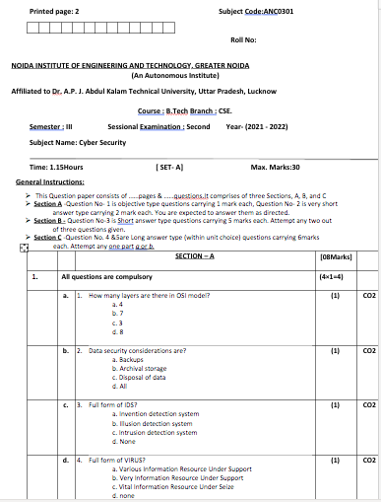
Past Sessional Papers

Slide 85
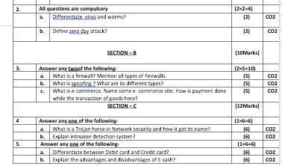
Past Sessional Papers

Slide 86
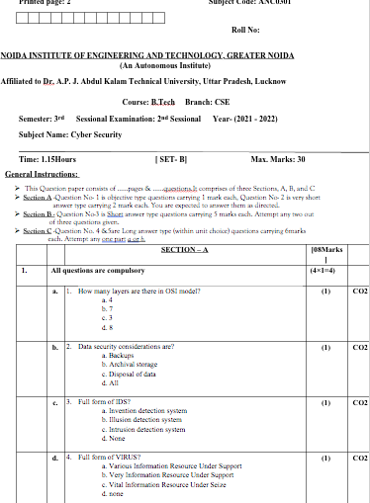
Past Sessional Papers

Slide 87
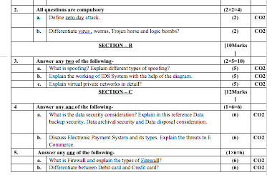
Past Sessional Papers

Slide 88
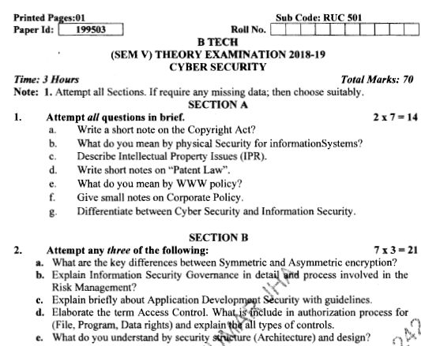
Old Question Papers

Slide 89
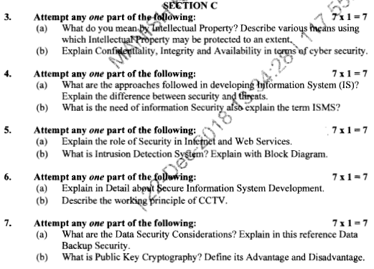
Old Question Papers

Slide 90
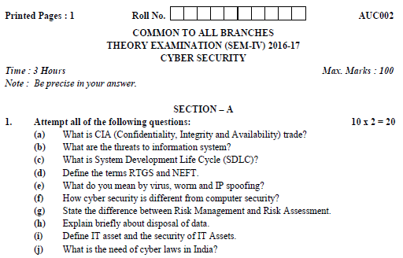
Old Question Papers

Slide 91
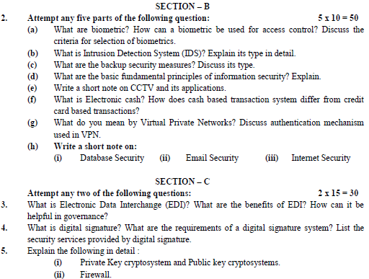
Old Question Papers

Slide 92
Expected Questions for University Exam
Distinguish between known and unknown vulnerabilities. How are they managed?
Illustrate the techniques used in securing mail system against spam.
Explain importance of web security.
Why security policies should be developed?
Explain key aspects in maintaining cloud security.

Slide 93
Summary
This PPT provides the important ideas of current world’s security problems. As the world is moving towards a digital era, users are increasing utilizing the web services, email systems, mobile devices and the cloud services.
The major topics covered are Development of Policies, WWW Policies, Email Security Policies, mobile security , cloud security.
The users should also be aware of selecting and using cloud resources and services. Hence, a proper maintenance and utilization of security measures is essential in preventing users against various attacks.

Slide 94
References
Charles P. Pfleeger, Shari Lawerance Pfleeger, “Analysing Computer Security ”, Pearson Education India.
V.K. Pachghare, “Cryptography and information Security”, PHI Learning Private Limited, Delhi India.
Dr. Surya Prakash Tripathi, Ritendra Goyal, Praveen kumar Shukla ,”Introduction to Information Security and Cyber Law” Willey Dreamtech Press.(prefer)
https://img2.helpnetsecurity.com/dl/reviews/157870264X.pdf
https://csrc.nist.gov/CSRC/media/Projects/Supply-Chain-Risk-Management/documents/briefings/Workshop-Brief-on-Cyber-Supply-Chain-Best-Practices.pdf
https://onlinecourses.swayam2.ac.in/cec20_cs09/unit?unit=96&lesson=112

Slide 95
Thank You

